Slide 1
Cognitive Bias and Security Vulnerabilities
The psychology of software engineering
Neil Dixley

Slide 2
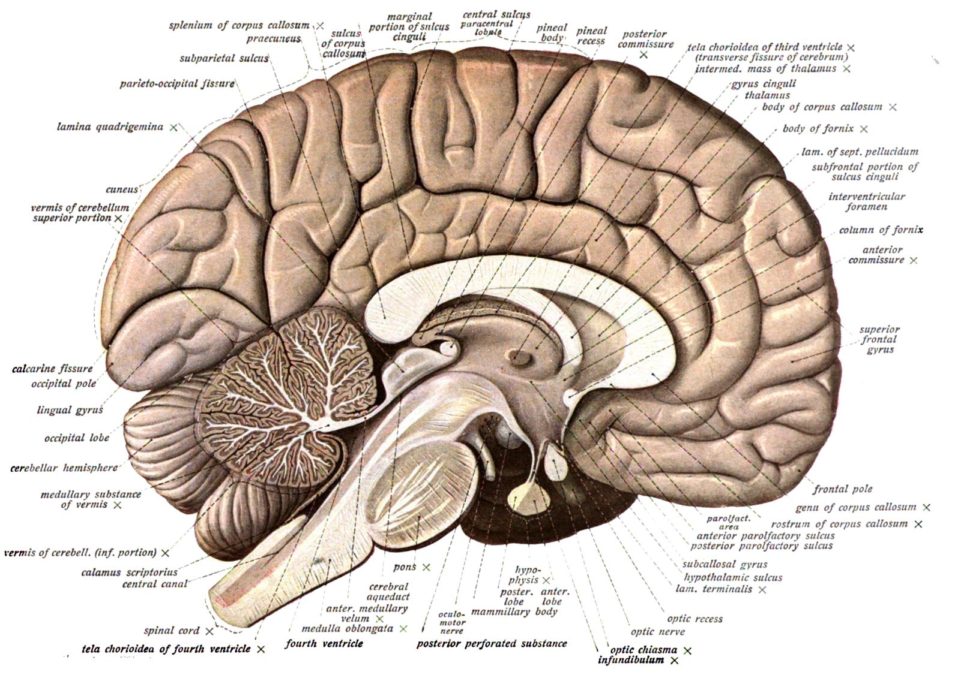
Cognitive

Slide 3
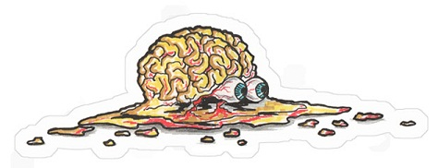
Security failures are cognitive failures

Slide 4

Two systems one brain
Considered
Effortful
Focused
Secondary
Slower
Lazy
Automatic
Intuitive
Instinctive
Primary
Rapid
Blind

Slide 5
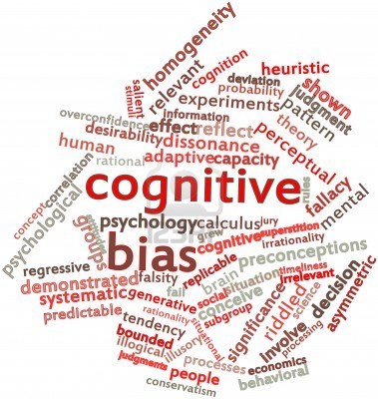
Cognitive Bias

Slide 6
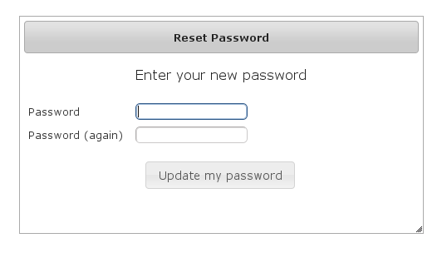
Anchoring

Slide 7
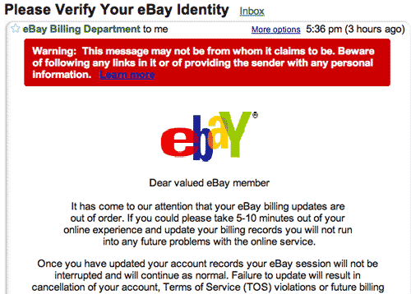
Loss Aversion

Slide 8

Principle of Authority

Slide 9

Mitigating cognitive failures

Slide 10
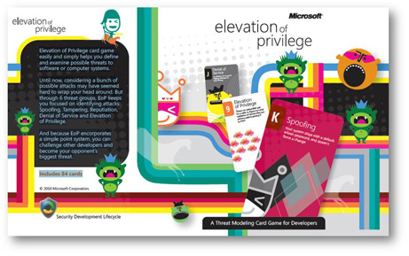
Threat Modelling

Slide 11
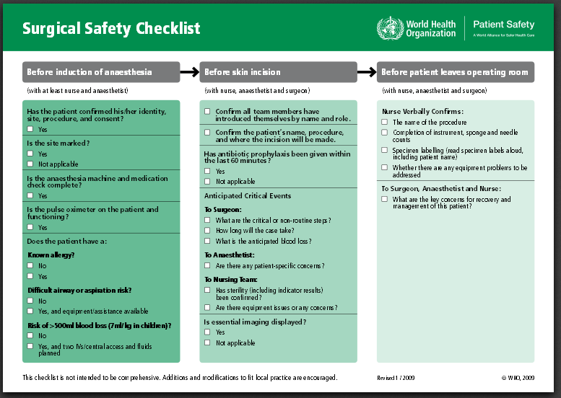
Check Lists

Slide 12

Security First

Slide 13
Further information
BBC Horizon – How we really make decisions
Wikipedia – List of Cognitive Biases
Cognitive Dissonance – the book
Cognitive Dissonance – the podcast

Slide 14

Thank you
Twitter : @neildixley
www.neildixley.com
Perfect Image

